Slide 1
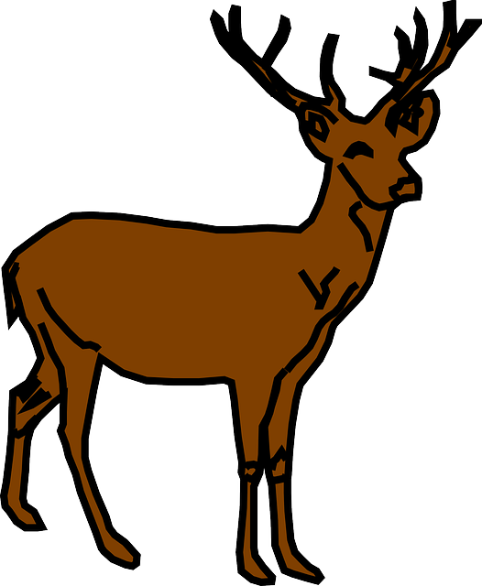
Reindeer Unit Literature Focus Unit Specifically for 4th Grade
EDU 315
Emily Steffl

Slide 2
Standards
Literature
RL.3- Describe in depth a character, setting, or event in a story or drama, showing specific details in texts
RI.2- Determine the main idea of a text and explain how it is supported by key details; summarize the text
RL.4- Read with sufficient accuracy and fluency to support comprehension
Writing
W.1- Write opinion pieces on topics of texts, supporting a point of view with reasons and information
W.2- Write information/explanatory texts to examine a topic and convey ideas and information clearly
W.3- Write narratives to develop real or imagined experiences or events using effective technique, descriptive details, and clear event sequences
W.7- Conduct short research projects that build knowledge through investigation of different aspects of a topic
Speaking
SL.1- Engage effectively in a range of collaborative discussions with diverse partners on grade 4 topics and texts, building on others’ ideas and expressing their own clearly
SL.2- Paraphrase portions of a text read aloud or information presented in diverse media and formats, including usually, quantitatively, and orally
SL.4- Report on a topic or text, tell a story, or recount an experience in an organized manner, using appropriate facts and relevant, descriptive details

Slide 3
Art
4.1.1- Know differences between visual art media
4.1.4- Know how differences between visual art processes
4.2.1- Know the differences among visual art structures and functions
4.2.2- Know how expressive images cause different responses and communicate ideas
Science
4-LS1. A- Structure and Function
4-ESS2. A- Earth Materials and Systems
4-LSS1.2- Use a model to descriptive that animals receive different types of information
Social Studies
4.1.2- Use map scales to locate physical features and estimate distance on a map
4.1.3- Create a mental map that demonstrates understanding of the relative location, direction, size and shape of the US
4.5.6- Describe ways geography has affected the development of the state over time

Slide 4
Math
4.0A.2- Multiply or divide to solve word problems involving multiplicative comparison by using drawings and equations with a symbol for the unknown number to represent the problem
4.MD.1- Know relative sizes of measurement units within one system of units including km, m, cm; kg, g; lb, oz; l, ml; hr, min, sec. Within a single system of measurement, express measurements in a larger unit in terms of a smaller unit. Record measurement equivalents in a two-column table. For example, know that 1 ft is 12 times as long as 1 in. Express the length of a 4 ft snake as 48 in. Generate a conversion table for feet and inches listing the number pairs
Physical Education
S1. E2.4- Runs for distance using a mature pattern
S2. E2.4- Combines movement concepts with skills in small- sided practice tasks
S2. E5.4- Applies simple offensive strategies and tactics in chasing and fleeing activities
Technology
K-5. 1A1. 4- Use basic search strategies to locate resources
K-5. 1A1.6- Evaluate information found within selected resources on the basics of accuracy, currency, reasonableness, and appropriateness
K-5. 1A1. 9- Organize information using technology and other tools

Slide 5
Literature
Non-Fiction
-Reindeer- Dee Phillips
-Reindeer: Nomads of the North- Caitlind Alexander
-Reindeer (A Day in the Life: Polar Animals)- Katie Marsico
Fiction
-Rudolph the Red-Nosed Reindeer- Kristen Z. Depken
-Rudolph Shines Again- Robert L. May
-A New Reindeer Friend- Jessica Julius
-Olive, the Other Reindeer- J. Otto Seibold

Slide 6
Theme Study
Students will take part in a thematic unit on reindeer. This unit will including reindeer in the subjects of reading, writing, social studies, science, math, art, music, and physical education
In these subjects, the students will learn about the reindeer, environment, habitat, diet, etc.

Slide 7
Language Arts: Reading
The students will be introduced to reindeer through different literature genres. These books will be both read aloud and part of Daily 5 rotations.

Slide 8
Language Arts: Writing/Art
Students will be create their own Rudolph the Red Nose Reindeer using descriptive words and drawings.
After creating a visual, the students will write a narrative about their own Rudolph

Slide 9
Language Arts: Speaking/Viewing Activities
Students will do “pair-and-share” with a partner and exchange narratives.
This “pair-and-share” will be performed in 2 ways:
1. Peer Correcting- grammar, spelling, structure
2. Share final draft
both “pair-and-share” will be done with different partners

Slide 10
Language Arts: Videos
Information about Reindeer -https://www.youtube.com/watch?v=8PvPXomxEgQ
Reindeer calf takes first steps…-https://www.youtube.com/watch?v=rm2KL5EWD30
Reindeer-Animals-PreSchool- Animated Educational for Kids-https://www.youtube.com/watch?v=9ZFllvRy5lM

Slide 11
Language Arts: Visually Representing Activities
Students will be assigned into small groups and will make a KWL chart and will add information as the unit progresses on

Slide 12
Science Activities
Students will first learn about the basics of reindeer
Habitat, diet, etc.
https://www.reindeerfarm.com/reindeer-sales.html
Students will then study about how animals come from families and are relatives deer, moose, caribou
Compare and contrast differences between deer, moose, and caribou using the internet or online sources

Slide 13
Mathematics
Students will have a mini lesson of different ways weight can be measured
Students will take their own weight/height
Students will compare reindeer to humans by measuring their weight and height

Slide 14
Social Studies
Students will demonstrate their mapping skills and locate on a map of the world where the reindeer live
Students will learn and study the “Reindeer people” and how they used the reindeer in their everyday life
http://kids.nationalgeographic.com/explore/countries/norway/#norway-fjord.jpg
Write/Reflect in Journal-
How are the “Reindeer people” different from you? How is it similar?
What is hard about their life?
Would you like to live in their community?

Slide 15
Art and Music Activities
See Language Art: Writing and Art
Watch Rudolph the Red Nosed Reindeer
Field Trip: Go to the Dakota Zoo to see the Reindeer

Slide 16
Physical Education Activities
Students will play Santa and Reindeer Tag
3-4 Students will be Santa while the rest are reindeer
Santa must run and tag any student that is a reindeer and take them to their pen
The reindeer can be tagged by any of the reindeer that are still running and free and can be let out of the pen

Slide 17
Technology
See corresponding links in slides

Slide 18
Assessments
Students will be-
Small groups will be assigned a certain topic about reindeer to present to class
Each student’s individual KWL chart
Each student’s personal narrative about reindeer
Participation in “pair-and-share” narrative activity
Personal journal reflection about the “Reindeer People”

Slide 19
Language Arts Strategies
Activating Background Knowledge- Students create their own KWL chart and add continuously throughout the unit
Compare/Contrast- Students compare and contrast between weight/height of reindeer and humans, differences between each animal in the reindeer family, their community vs the community of the “Reindeer People”
Visualizing- Create a visual of a reindeer in their personal narrative
Playing with language- Students will try to use colorful language in their personal narratives
Pair-and-Share- Students will pair-and-share their personal narratives with a partner and will work collaboratively
Research- Students will perform research on reindeer with small group final assessment

Slide 20
Grouping Patterns
Large Group- conversations as class during main lessons, videos, physical education game, Dakota Zoo fieldtrip
Small Group- Daily 5 readings, pair-and-share, KWL chart, small group final assessment project
Individual- Daily 5 readings, personal narrative, science activity with compare and contrasting in the reindeer family, weight/height activity, social studies reflection journal

Slide 21
 | Subject | Monday | Tuesday | Wednesday | Thursday | Friday
MORNING | Language Arts | -KWL Chart -Read 2 diff. genres about reindeer | -Write a narrative about own Rudolph | -Continue writing narrative | -Pair/Share narratives -Peer editing narratives | -Complete KWL chart
 | Art/Music | -Video- Reindeer Animals- Preschool | -Draw own reindeer for narrative | -Continue to work on reindeer | -Video- Info about Reindeer | -Rudolph the Red Nosed Reindeer Movie
 | Physical Education | -Relay Races | -Reindeer Game | -Reindeer vs Santa Kickball | -Stations | -Rudolph the Red Nosed Reindeer Movie
AFTERNOON | Math | -Mini lesson of Standard 4. MD.1 | -Take weight of students | -Practice changing weights into different labels | -Take height of students | -Compare individual/ class to reindeer weight and height
 | Science | -Learn basics of reindeer *website and notes | -Study and learn how animals can come from similar ancestors | -Compare and Contrast between different branches of same family | -Technology Partner Research Project | -Present Technology Partner Research Project
 | Social Studies | -Locate on map where reindeer live | -Watch video of Reindeer People and Journal Reflection | -Review the Reindeer People video and compare and contrast similarities and differences | -Pair/ Share in small groups and record | -Locate on map Reindeer People and discuss location

